Slide 1






UX CASE STUDY
FestiVerse
Discover, Connect & Celebrate College Fests
Aprill 4, 2025

Slide 2


Introduction
“Despite the enthusiasm for college fests, students struggle to discover events, understand details, and manage participation across colleges.”
Key Challenges
No centralized fest directory
Poor access to details/tickets
Unclear promotion methods
Fest PR relies heavily on social media & word of mouth

Slide 3
Overview
FestiVerse is your ultimate gateway to discovering and celebrating fests. Whether you're into music, art, food, culture, or seasonal gatherings, FestiVerse connects you to experiences that match your vibe. The app curates events based on your interests and location, giving you a personalized feed of upcoming fests. With real-time updates, schedule details, and insider tips, you’re always in the loop and ready to join the fun.
FestiVerse isn’t just for attendees — it’s a powerful platform for fest organizing committees too. Whether you're planning a college fest, cultural event, or a large-scale music fest, FestiVerse helps you promote your event to a targeted and enthusiastic audience. Organizers can create official event pages, post updates, share schedules, open registrations, and manage PR all in one place. With tools to engage directly with attendees, boost visibility, and gather insights, FestiVerse makes it easier than ever to bring your fest to life and build lasting buzz around it.

Slide 4




Goals
1.
2.
3.
Build a centralized, user-friendly platform for students to discover, explore, and participate in college fests.
Provide organizers with tools to manage event visibility and PR.
Simplify access to fest details, tickets, and reminders.

Slide 5
Competitor Analysis
One app which is popular and can be a competitor is BookMyShow. It is a leading platform primarily focused on ticketing for movies, live performances, concerts, and large-scale events. It excels in offering a smooth ticket booking experience and is known for its extensive partnerships with cinemas and entertainment venues.
Unlike BookMyShow, which focuses primarily on ticketing for movies and large-scale entertainment events, FestiVerse is designed specifically for fests. It offers a space not only for attendees to discover and enjoy events, but also for organizing committees to promote, manage, and connect with their audience. With built-in social features, personalized discovery, and a community-driven vibe, FestiVerse goes beyond booking — it’s about building and experiencing the fest culture from the ground up.

Slide 6
User Persona

Slide 7
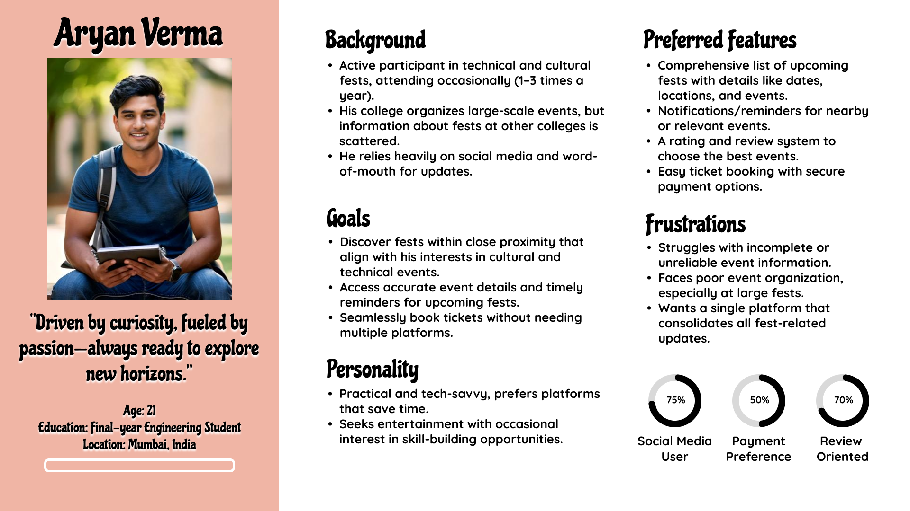

Slide 8
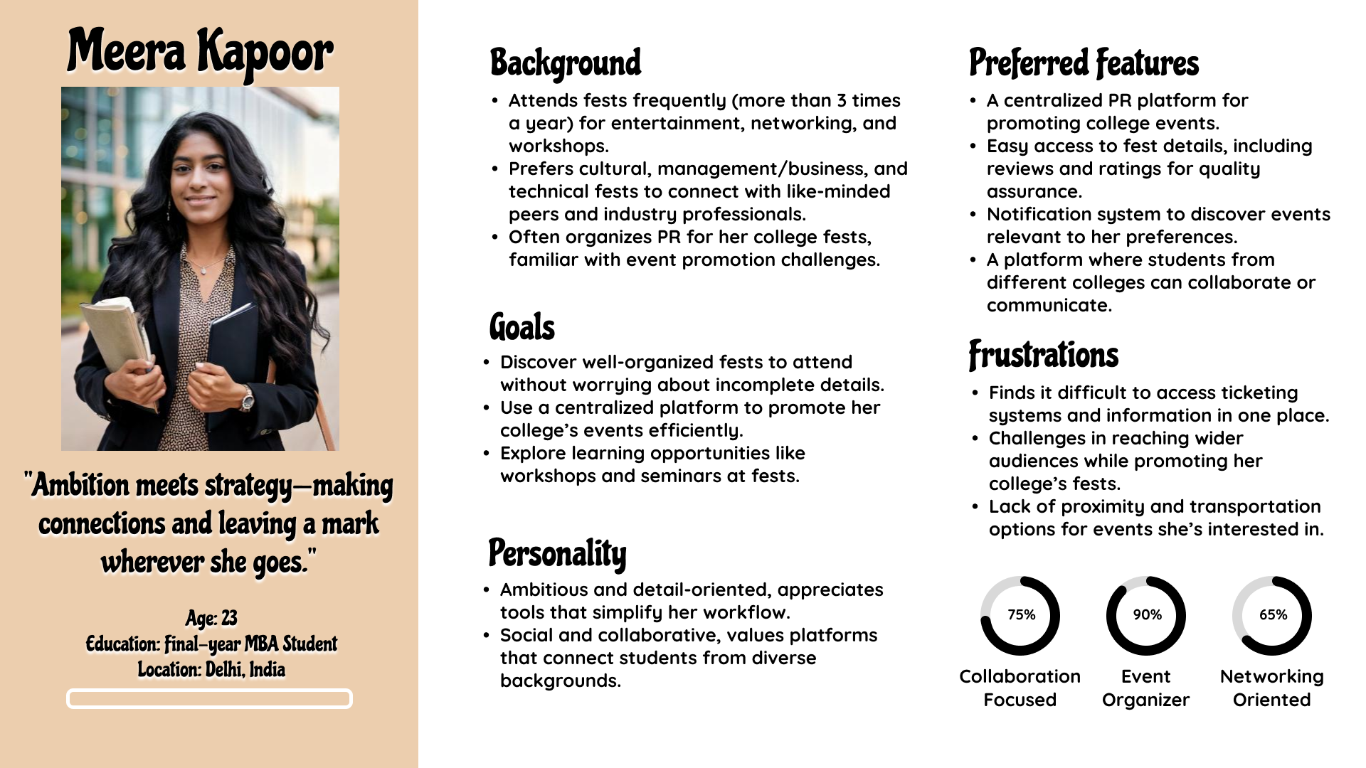

Slide 9

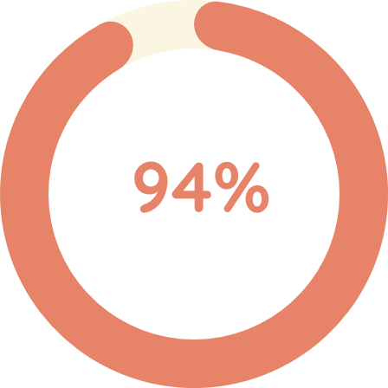
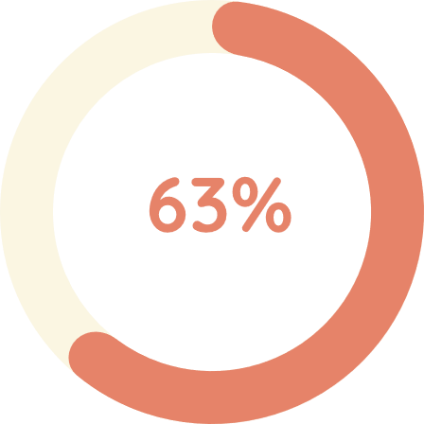
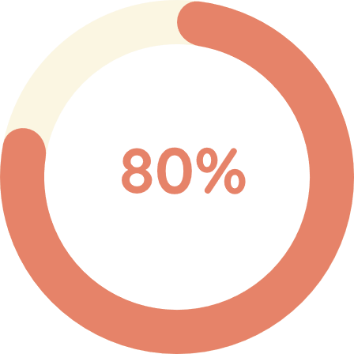
Survey Insights
Respondents aged 18–24
Want fests close to location
Discover fests via social media
Interested in a fest platform
Top Features Wanted: Ticket Booking, Fest Listings, Notifications

Slide 10
Point Of View
"College students who love attending fests need a reliable and centralized source to discover, evaluate, and access college events because current discovery methods are fragmented and inefficient."
How Might We?
How might we make fest discovery seamless across colleges?
How might we build trust in fest info and organization?
How might we simplify PR for event organizers?
How might we help students manage participation better?

Slide 11
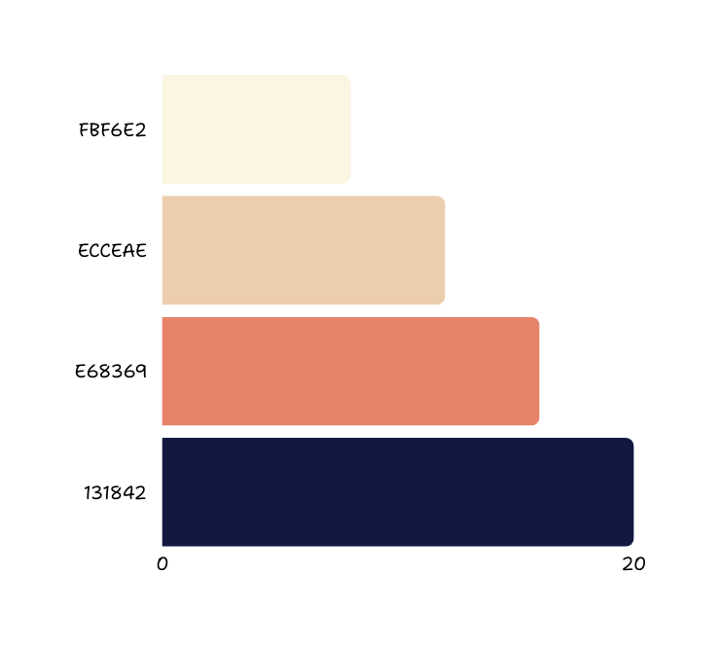
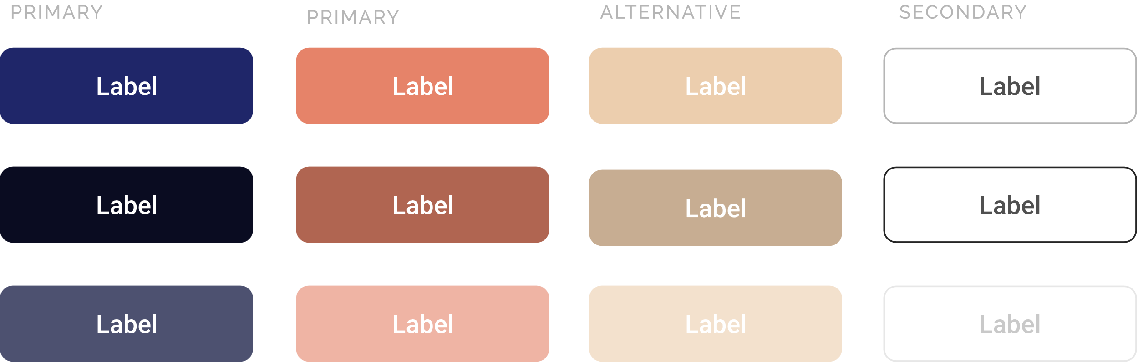
Style Guide

Slide 12
Typography
Aa
Typeface : Raleway
Font : Regular
Aa
Typeface : Nunito
Font : Medium
Aa
Typeface : Shantell Sans
Font : Medium

Slide 13

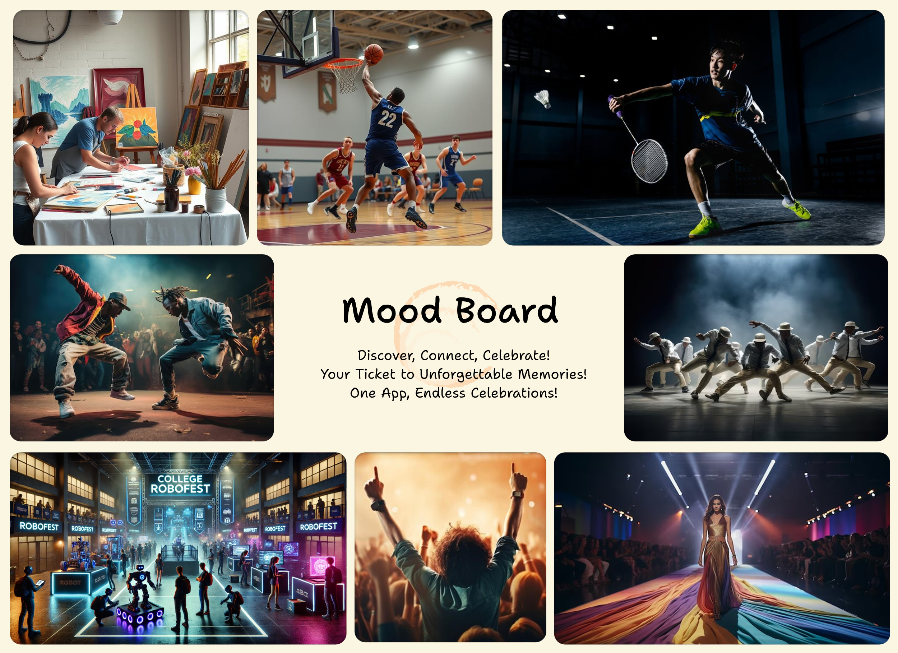

Slide 14
User Journey Map

Slide 15
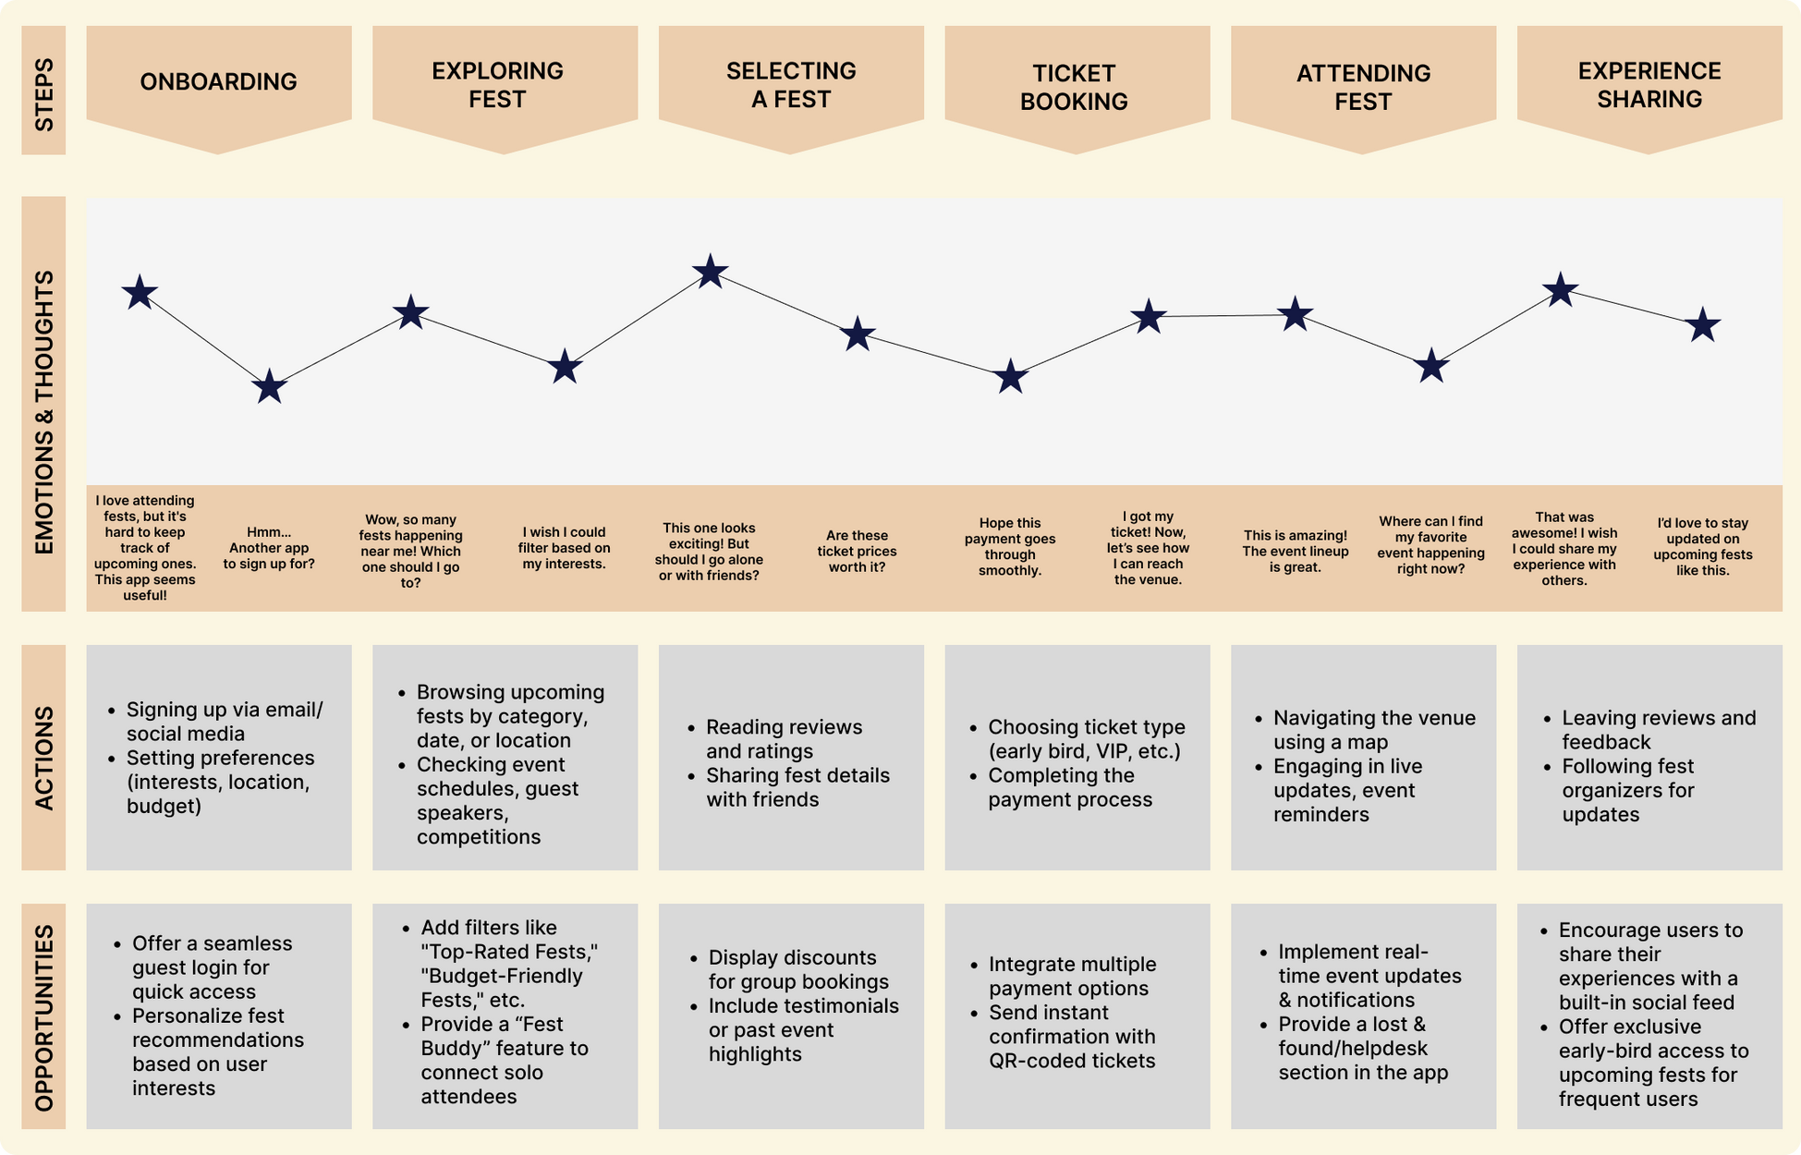

Slide 16
Flowchart

Slide 17
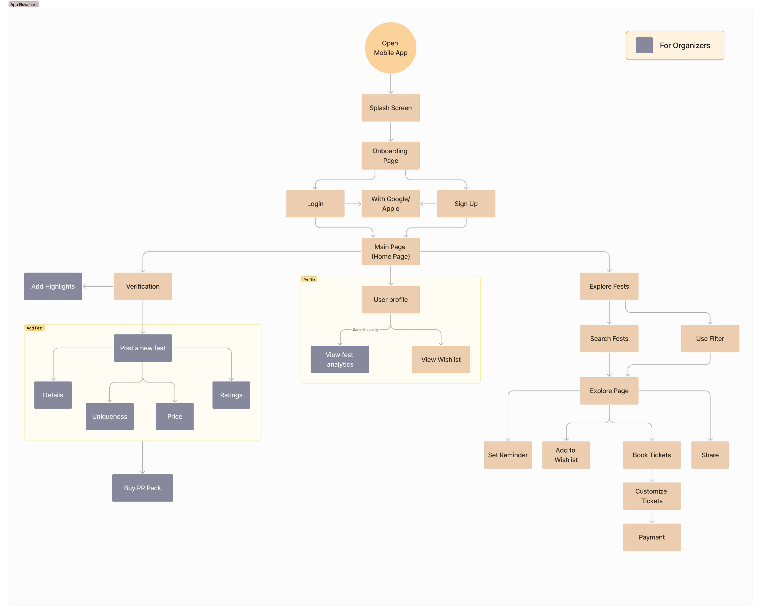

Slide 18
Wireframes

Slide 19

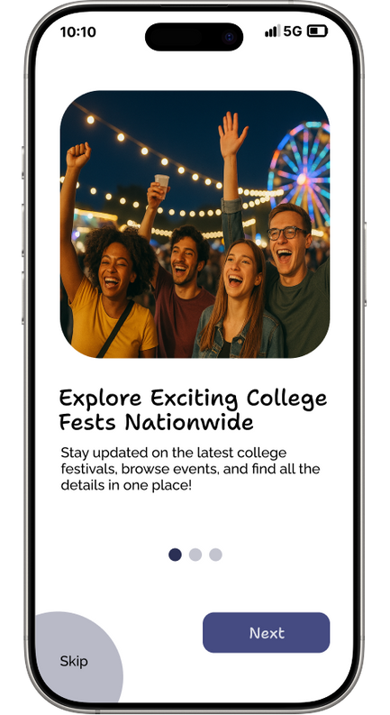
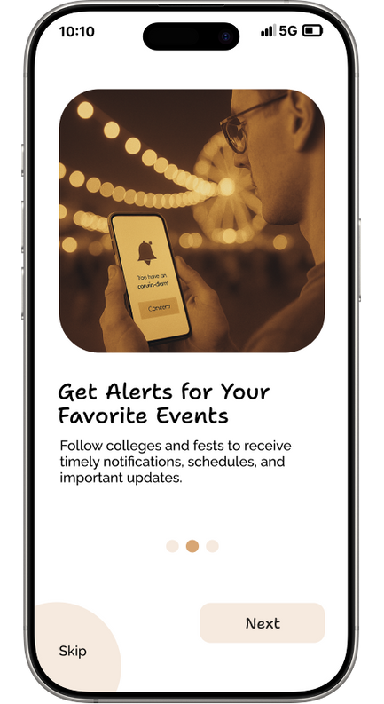
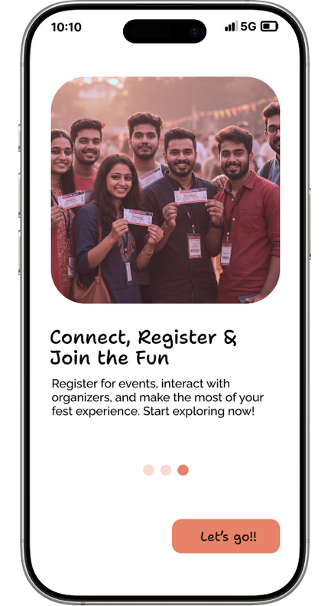
Onboarding page

Slide 20

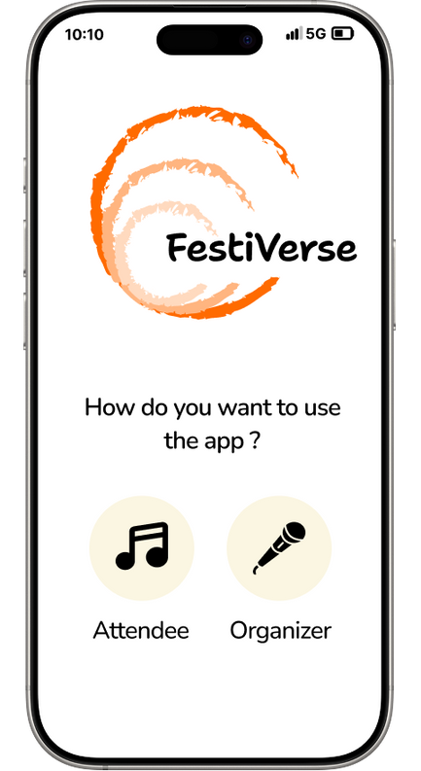
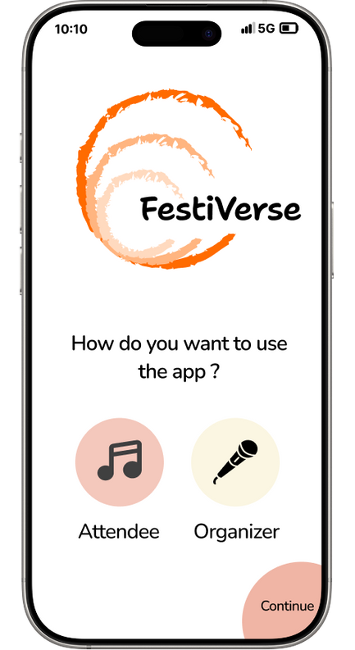
Home page

Slide 21
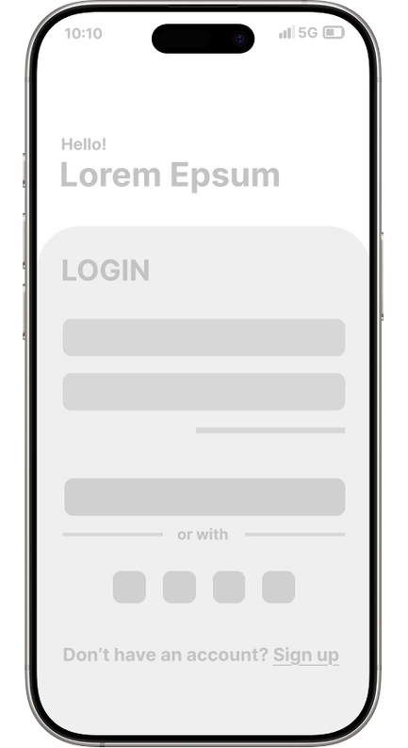
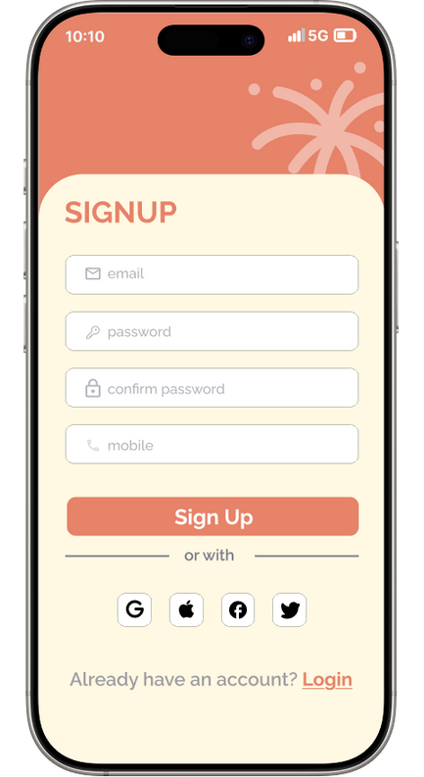
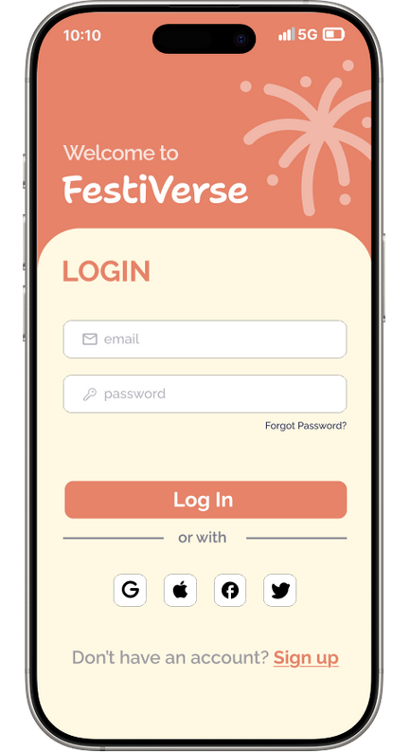
Login / Signup for Attendees

Slide 22
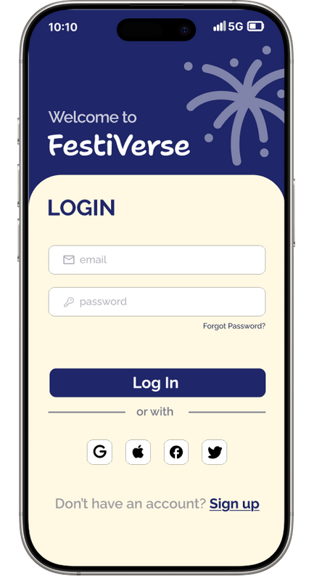
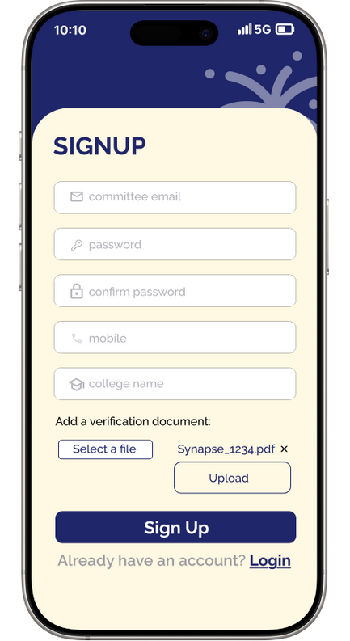
Login / Signup for Organizers

Slide 23

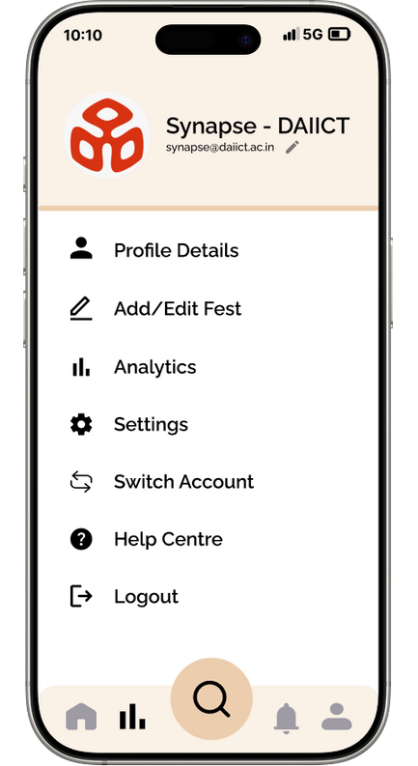
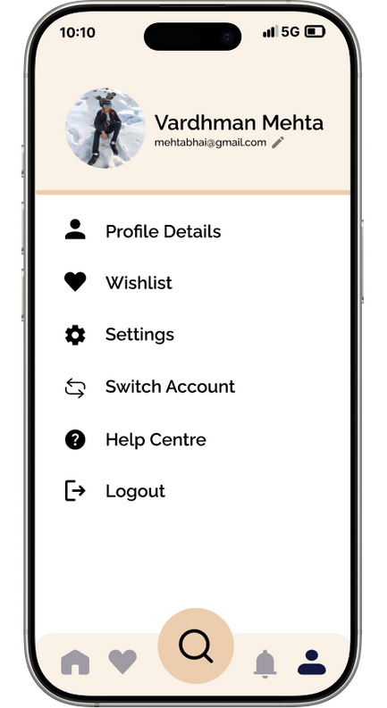
Profile page

Slide 24
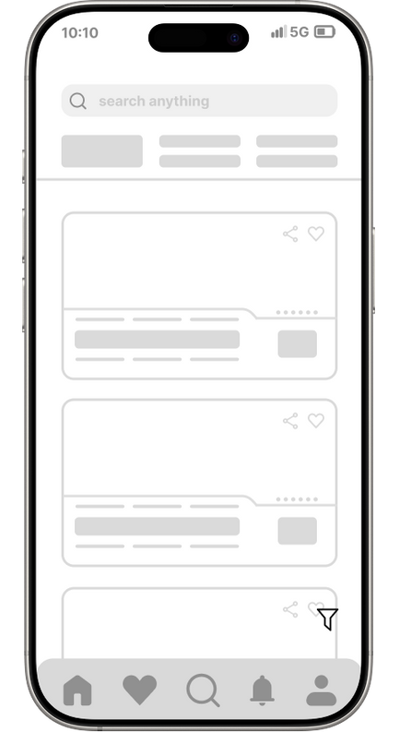
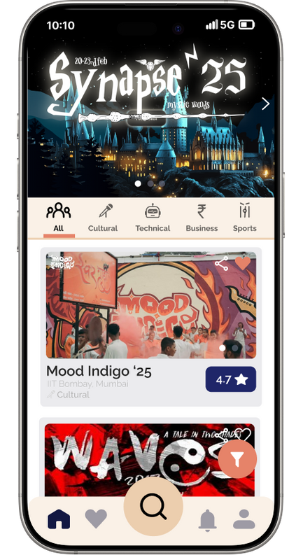
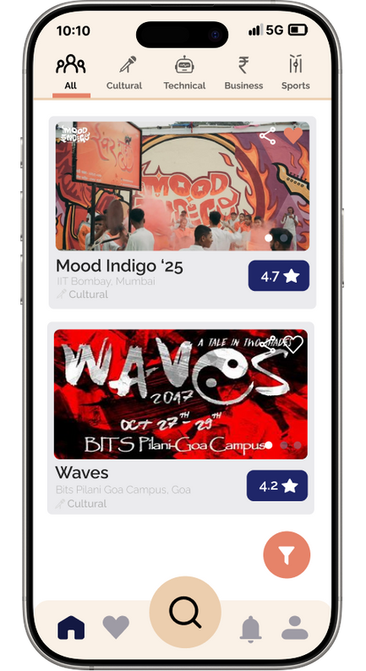
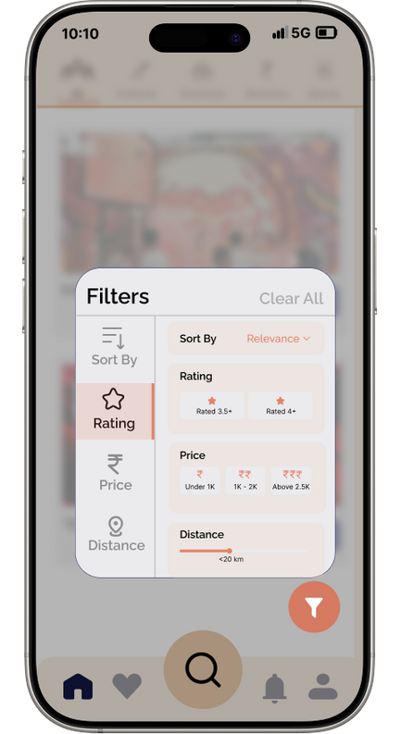
Exploration page

Slide 25
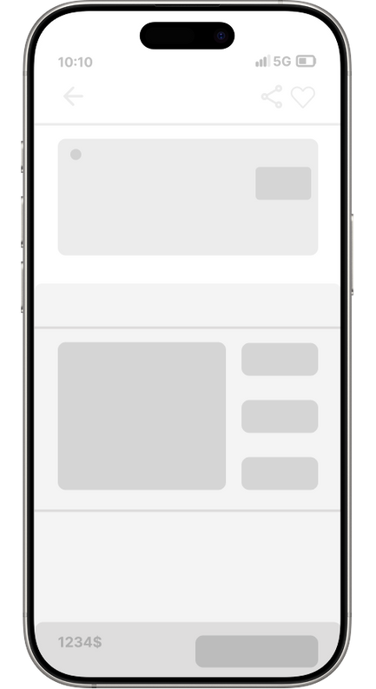
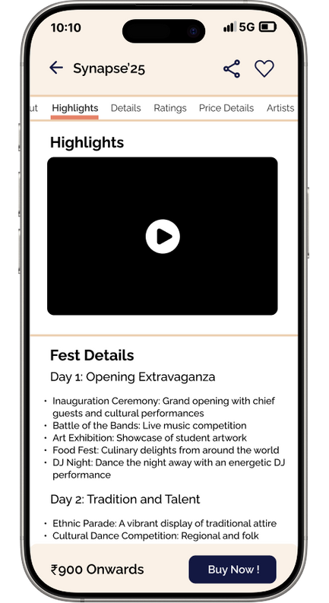
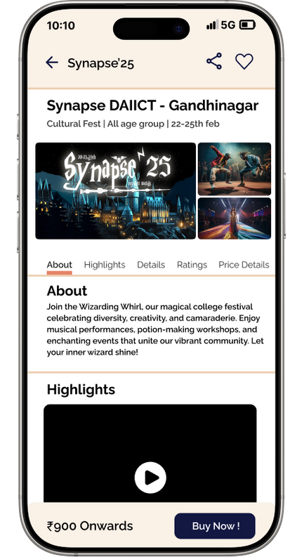
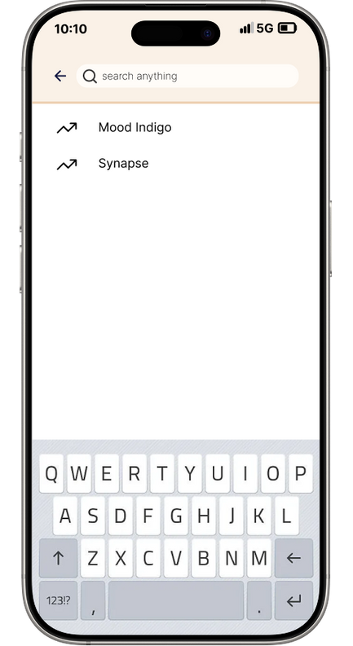
Fest Details page

Slide 26
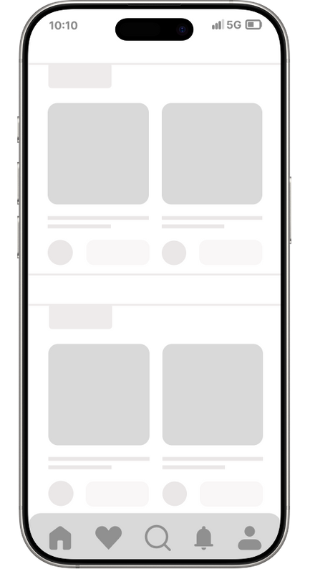
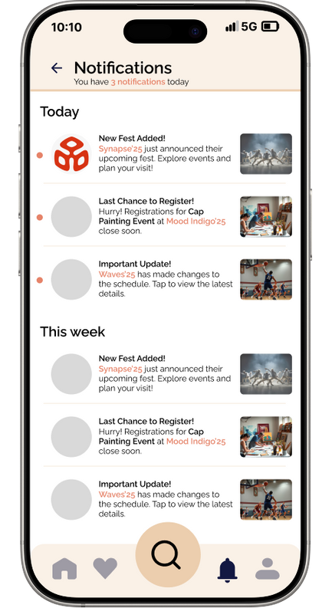
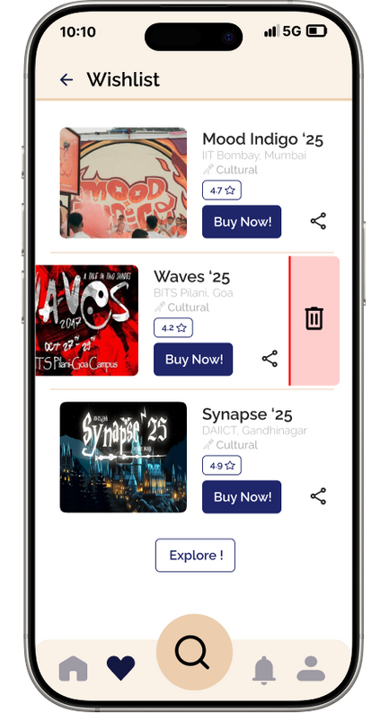
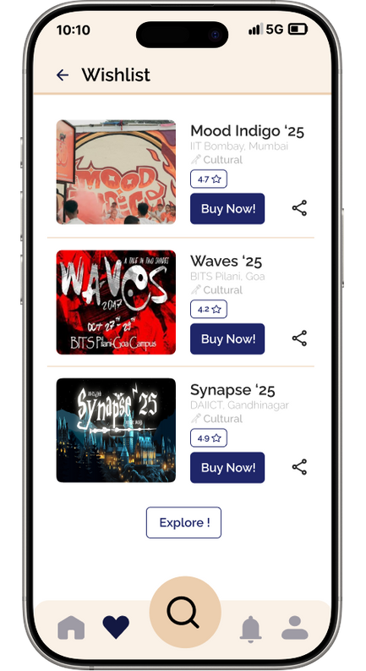
Wishlist and Notifications

Slide 27
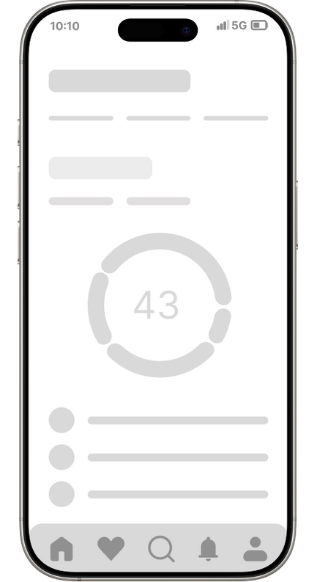
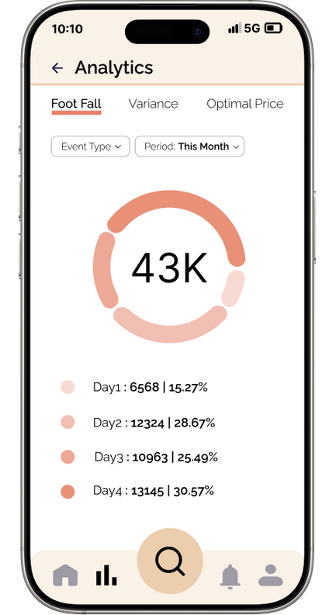
Analytics Page

Slide 28
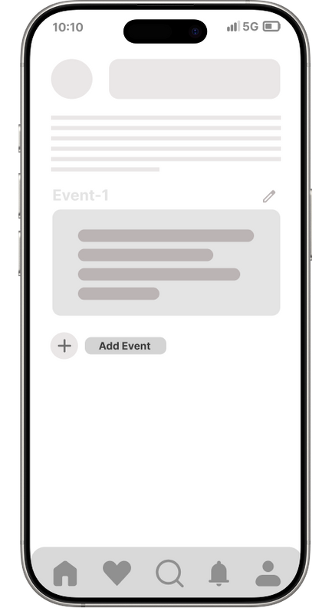
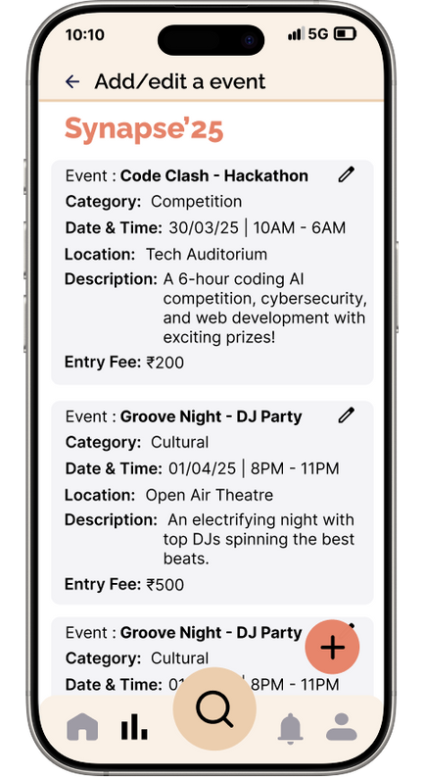
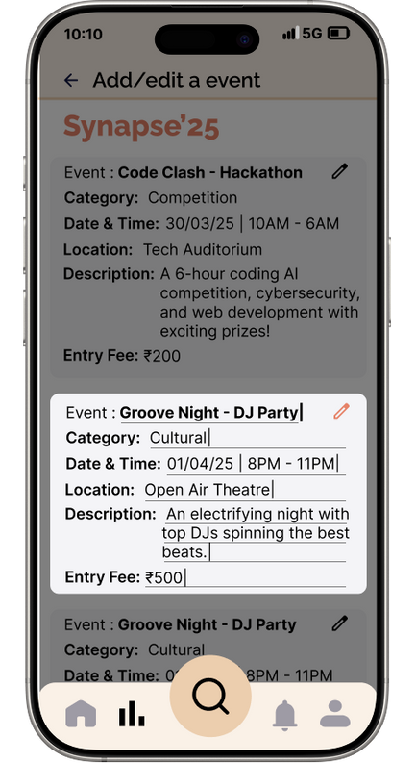
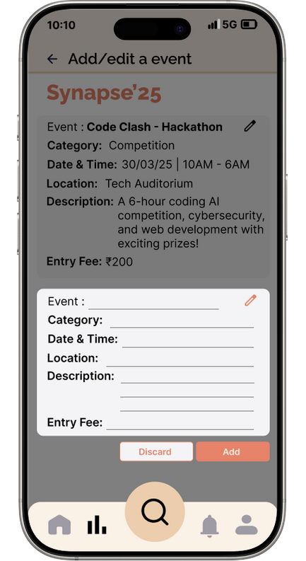
Edit Page

Slide 29
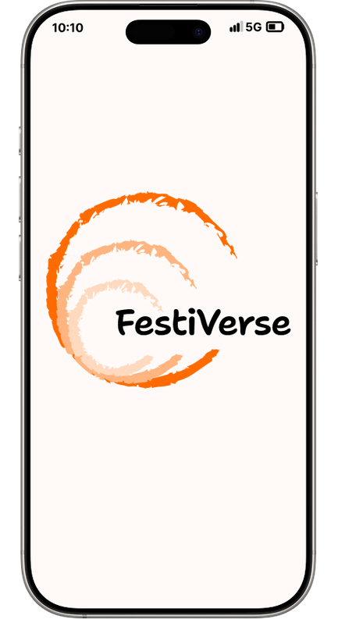


Thank You
Let the celebration begin.
With FestiVerse, every fest is just a tap away.

